Slide 1
Increasing Participation and Profit And Loss
Provided by the LAUSD Food Services Division
Notes:
TELL: THIS IS JUST A PLACE HOLDER FOR SCREEN BEFORE THE PRESENTATION IS READY TO BEGIN

Slide 2
Increasing Participation and Profit And Loss
Provided by the LAUSD Food Services Division
Notes:
TELL: Welcome to the Controlling Cost training. Thank you for joining us here today. My name is _______________ .

Slide 3
Overview
A successful food service program requires a careful analysis of financial data.
This training will focus on:
Business savvy skills
How to increase participation
Where profit comes from
Controlling Cost
Recognizing and understanding profit and loss
Notes:
TELL: Controlling cost can have the greatest impact on the financial success of a food service program. It requires a careful review and analysis of financial data. Today’s training will focus on business savvy skills, how to increase participation, where profit comes from, controlling cost, recognizing and understanding profit and loss.
NEXT SLIDE:

Slide 4
Business Skills
Business savvy skills provide managers the ability to:
Effectively communicate ideas to others
See the “big picture” of the organization
Understand impact of actions and decisions
Use knowledge to make good decisions
Understand important organizational data
Notes:
TELL: Being Business Savvy has emerged as a vehicle for improving financial performance and leadership development. A business savvy person understands how the moving parts of a company work together to make it successful and how financial metrics like profit margin and cash flow reflect how well each of those moving parts is doing its job. These skills provide managers the ability to; Effectively communicate ideas to others, wee the “big picture” of the organization, understand impact of actions and decisions, use knowledge to make good decisions, and understand the important organizational data.

Slide 5
6 Attributes of a Business Savvy Manager
Effective managers are skilled at the following attributes:
Communicator
Financial analyst
Problem solver
Participation builder
Planner
Professional development advocate
Notes:
TELL: By analyzing the essential business savvy skills, a list of characteristics emerges that make up a well rounded, business savvy person. As you review this list, you’ll see some categories where you naturally thrive and others that represent a challenge to you. We will take each attribute and discuss them in more detail. The 6 attributes are being a communicator, financial analyst, problem solver, participation builder, planner and professional development advocate.

Slide 6
Communicator
There are a variety of ways to get a message across to team members.
Written
Visual
Recipes
Work Schedules
The 4 Types of Communication
Show-Tell-Do
Body Language
Provide Instructions
Non-Verbal
Verbal
Notes:
TELL: A business savvy individual is certainly one who is a great communicator. They demonstrate this with their ability to successfully communicate with individuals across a business, their network and throughout the wider community. The mark of a business expert is often their ability to know their people as well as they know their business. This is reflected through their ability to effectively and productively manage the different personalities and skill-sets that comprise both their business and their working network. An effective communicator will use the 4 types of communication which are verbal, non- verbal, visual, and written.

Slide 7
Financial Analyst
A financial analyst has the knowledge to work with budgets, and numerical functions of an operation.
Understand financial reports
Profit and Loss
Target meal cost
Dash Board
Missing meal counts
Accurate while entering data
Being mindful to check all paperwork such as production records, meals counts, and numbers entered into CMS.
Notes:
TELL: When a business person is identified as business savvy, you can be certain that they will have a fantastic understanding of the numerical functions of their business. They think beyond mere accounting. They can quote figures for the top metrics, cite the latest participation numbers, and put their finger on the tipping point where an offering drives more students to the cafeteria. They will have an understanding of financial reports such as profit and loss and be mindful to be accurate while completing paperwork and entering numbers into CMS for reimbursement.

Slide 8
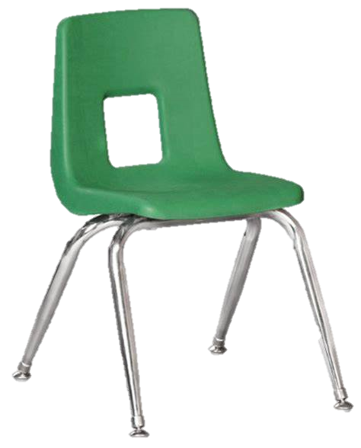
Participation Builder
Ambience
Food variety
Presentation
Efficiency
Consistency
Customer service
A participation builder knows the wants and needs of their customers. They offer the best:
Notes:
TELL: If reimbursement is the life of our business then Participation and sales can operate like its heart, pumping in cash and ensuring that the business grows and thrives. That’s why a business savvy leader will understand the importance and logistics of sales and participation in relation to business in general and their business in particular. A participation builder knows the wants and needs of their customers. They offer the best, ambience, food variety, presentation, efficiency, consistency, and customer service.

Slide 9
Problem Solver
The ability to identify an issue and find solutions and potential ways to improve, adapt and implement changes.
Step 1
Step 2
Step 3
Step 4
Step 5
Identify the Issue
Define & Analyze
Potential Solutions
Decision Making
Evaluate Success
What is the issue?
Why is the issue happening?
Determine
what will solve the issue?
Select and apply the solution.
Was the solution successful?
If a solution was not successful, re-evaluate the plan and try again.
Notes:
TELL: For business a savvy person, problem solving is very much a soft skill – one that has been embedded in their personalities for a long time. Whether at home or the office, or anywhere in between. You can present these individuals with something that’s not working and their brains will fire up with a list of solutions and potential ways to improve, adapt and implement their changes. Lets review a step by step method to problem solving. Step 1 identify the issue, what is the issue? Step 2 define & analyze, why is the issue happening. Step 3 potential solutions, determine what action will solve the issue. Step 4 decision making, select and apply solution. Step 5 evaluate success, was the solution successful. If the solution was not successful, re-evaluate and try, try again. There is always a solution to every problem.

Slide 10
Problem Solving To Build Participation
Identifying why students don’t choose Café LA as their dining option can help find potential solutions.
Large campus
No time to travel from classroom to cafeteria
Students attend club meetings during lunch
Long lines at cafeteria and serving windows
Sporting or campus events
Rallies, assemblies, fundraisers
Food delivery apps
Place mobile carts in areas where students don’t usually visit that cafeteria:
Across campus from the cafeteria
Near rooms that hold club meetings during lunch
Notes:
TELL: In order to build participation a food service manager will need to use their problem solving skills and identify why students are not choosing Café LA as their dining option. Lets review potential issues that may be causing low participation; large campuses, where students have no time to travel their classrooms to the cafeteria, students attending club meetings during lunch, long lines at cafeteria and serving windows, sporting or campus events like rallies, assemblies, and fundraisers, and finally food delivery apps.

Slide 11
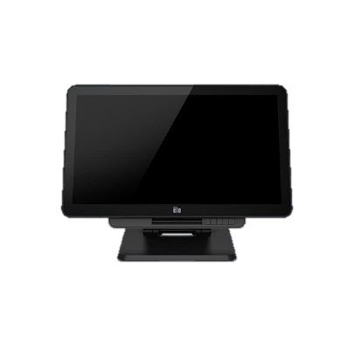
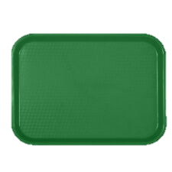
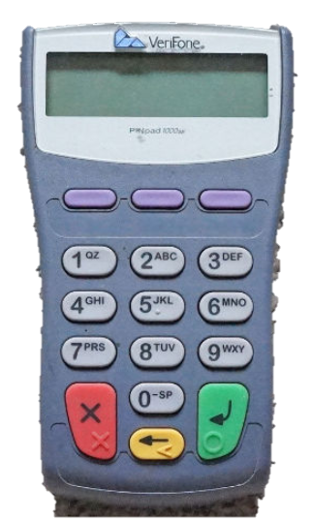
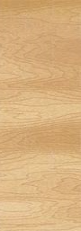
Solutions to Build Participation
Building student participation will require on-going new ideas for the cafeteria. Some examples are:
Rearrange the service line to better serve students.
Small changes can speed up the efficiency of serving students.
Notes:
TELL: Building student participation will require on-going new ideas for the cafeteria. Some examples are: Rearrange the service line to better serve students. By making small changes like this one, you can speed up the efficiency of serving students.

Slide 12
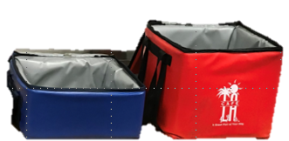
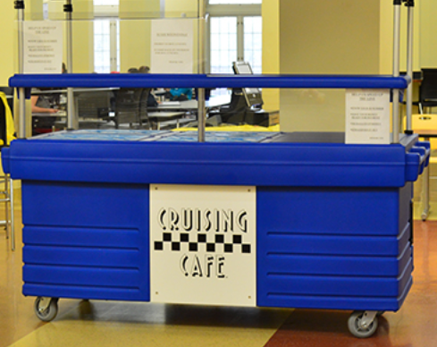
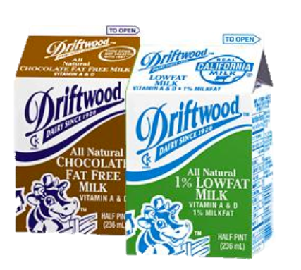
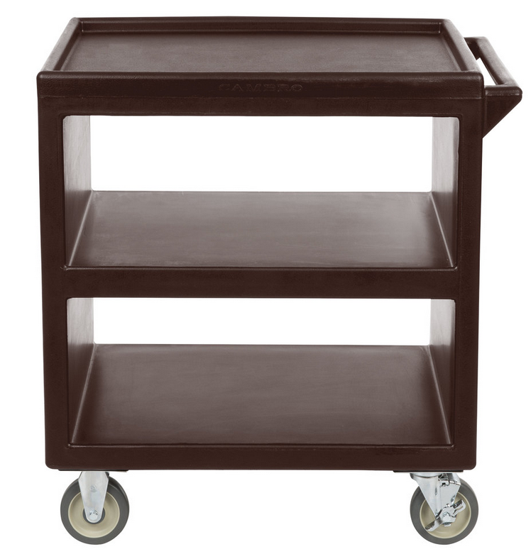
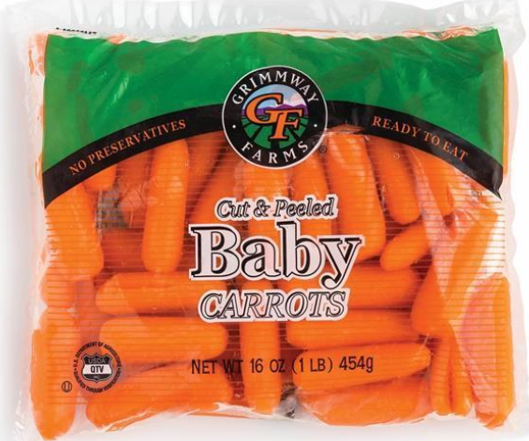
Solutions to Build Participation, Cont;
Building participation takes “outside of the box”, and “outside of the cafeteria” ideas.
DON’T HAVE A MOBILE CART?
FOOD FOR THOUGHT
Mobile Lunch Carts
To build participation, place a mobile cart away from the cafeteria to serve students who are not already eating with Café LA.
Finding participation solutions will contribute to the overall profit of a cafeteria and the Division.
Free reimbursement rate at
$3.18 x 180 school days =
$22,896 a year.
If you served 40 additional students a day using a cart, how much revenue could your cafeteria receive?
WHY NOT MAKE YOUR OWN?
$10,200
$15,200
$22,896
Notes:
TELL: Building participation takes “outside of the box”, and “outside of the cafeteria” ideas. To build participation try placing a mobile cart away from the cafeteria to serve students who are not already eating with Café LA. Don’t have a mobile cart? Why not make your own? Food For thought, if you served 40 additional student per day using a mobile cart, how much revenue would the cafeteria receive? That’s right $22,896 based on free reimbursement of 40 meals per day times 180 operation school days. That’s a huge success. Finding participation solutions will contribute to the overall profit of a cafeteria and the Division.

Slide 13
Treehouse Activity
Sally the Squirrel just opened Squirrel Café, she offers quality food at an affordable price but not all the animals seem to come inside to eat.
SQUIRREL CAFE
Notes:
TELL: Sally the Squirrel just opened Squirrel Café, she offers quality food at an affordable price but not all the animals seem to come inside to eat.
INSTRUCTOR: Instruct the class to get it groups of 3 to 5 people. Hand out 1 flash card per group and instruct the groups to pick a leader to write downs ideas.

Slide 14
Open for Business!
SQUIRREL CAFE
How can she feed all of the animals that are not able to make it to the café?
Notes:
TELL: Sally’s Squirrel Café is high up in a treehouse.
ASK: How can she feed all of the animals that are not able to make it to the café?
Action: Give the groups 5 minutes to discuss.
Action: Have each group share their ideas on how to feed all the animals.
ASK: How can this activity relate back to your cafeterias?

Slide 15
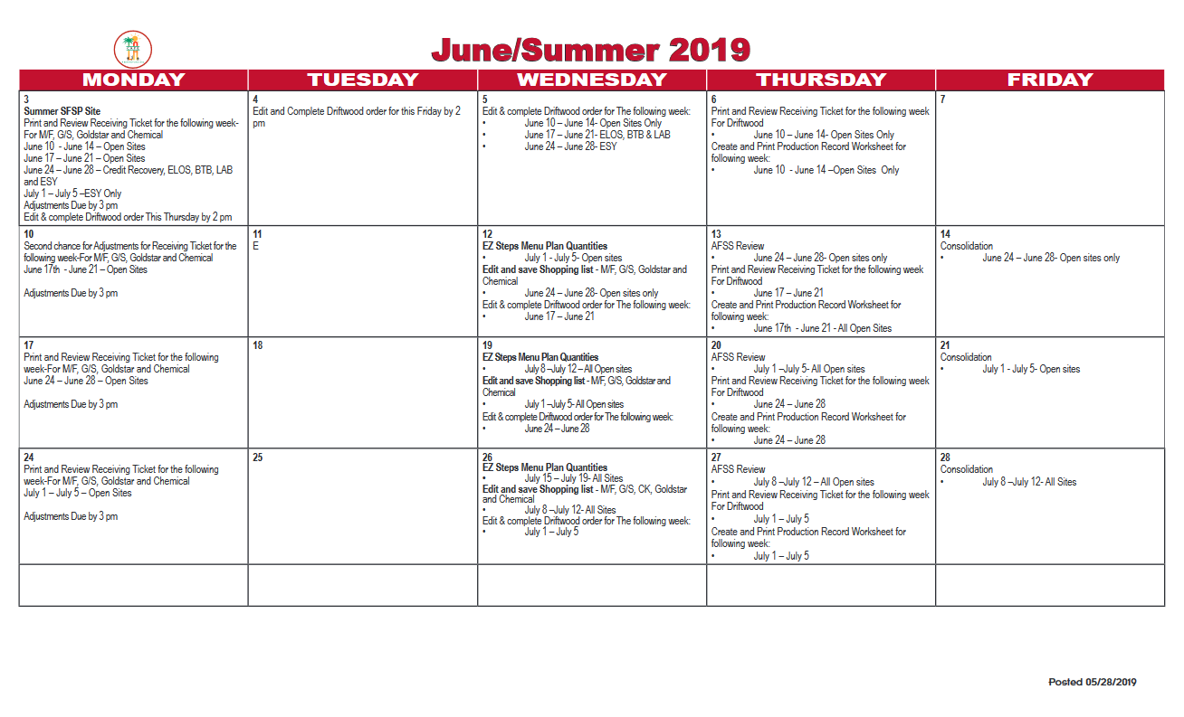
Organization and Planning
A planner knows their time is limited. By planning ahead they can accomplish more in the day.
Time Management
Daily tasks
Meetings
Employee vacation
Meet Deadlines
Trainings
CMS
Inventory
Ordering
CMS Ordering Calendar
Notes:
A planner will use time management for daily tasks, meetings, and even scheduling ahead for an employees absence from the cafeteria. Planning a head of time will assist in meeting deadlines for things like trainings, and CMS ordering. A business savvy individual understands both the solution and the steps required to get the solution to be implemented. This high level of understanding makes them excellent planners.

Slide 16
What type of calendar do managers already use?
Calendar Management
Calendar management is planning for an event or task on a specific date or time.
Notes:
TELL: Calendar management is planning for an event or task on a specific date or time. What type of calendars do managers already use? That’s right! The CMS Ordering Calendar. This is a value document that can be used to track other task all in one place.

Slide 17
It’s Not Just An Ordering Calendar, Cont.
Increase Participation by 10 Students This Month
Mobile Cart’s First Day
Analyze Cart Participations
Evaluate Successes
Employee On Vac For 1 Week
Notes:
TELL: Here is an example of how the ordering calendar can be used to plan ahead, meet deadlines and set goals. Marking the handwritten plans in red can insure they are seen as separate from the ordering calendar instructions. At the top of the ordering calendar the cafeteria’s goal are written in, they are to increase participation by 10 students this month. The cafeteria has an exciting first week, they will start their mobile cart, analyze the carts participation and evaluate the week’s successes. Lastly there will be an employee out on vacation for 1 week, by placing a reminder, the manager can plan ahead for operating while being short staffed.

Slide 18
Professional Development
Professional development enables individuals to
become more effective in the workplace, advance in their career and move into new positions where they can lead, manage, influence, and coach others. Available resources;
YouTube; Ted Talk, Tech Talk, tutorials
MyPLN, ServeSafe, ICN, APEX Learning
District tuition reimbursement for classes related to your job class.
SEIU up to $600 per year
Teamsters up to $800 per year
Notes:
Professional development enables individuals to become more effective in the workplace, advance in their career and move into new positions where they can lead, manage, influence, and coach others.
Available resources;
YouTube; Ted Talk, Tech Talk, tutorials, etc.
MyPLN, ServeSafe, ICN, and APEX Learning
District tuition reimbursement for classes that are related to your job class.
SEIU receive up to $600 per year
Teamsters receive up to $800 per year

Slide 19
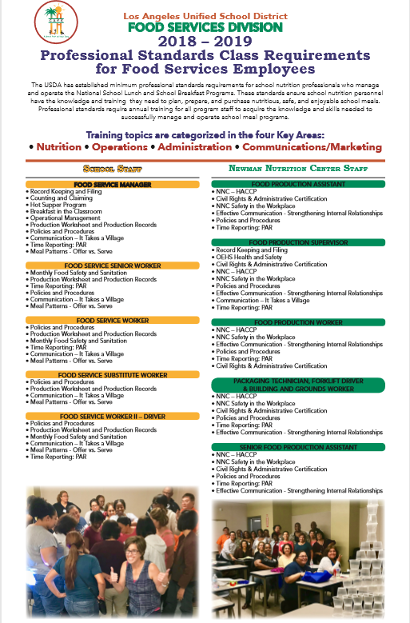
Professional Development Advocate
Understands the importance of Professional Standards to enhance jobs skills of oneself and employees.
Each job title has a required number of training hours they must complete each fiscal year.
NOTE: Training Brochure is located on the FSD website under “Training and Resources”.
Notes:
Business savvy leaders know that adding to your knowledge and skill set through professional development builds confidence and establishes credibility. Whether it’s a webinar on CEP fundamentals, a course on evaluation best practices or an online training about supper or offer vs serve, reinforcing your knowledge of Food Services programs sets you up to be the go to person for important answers.

Slide 20
The Managers Role
The manager is responsible for planning and maintaining work systems, procedures, and policies that enable and encourage the optimum performance of it’s people and other resources within a business unit.
Notes:
TELL: The manager is responsible for planning and maintaining work systems, procedures, and policies that enable and encourage the optimum performance of it’s people and other resources within a business unit.

Slide 21
Where Does Our Profit Comes From?
Having a successful business requires an understanding of the operation’s finances. Lets review where profit comes from:
$ Labor
& Benefits
Ala Carte Sales
$ Over-head
$ Food
State & Federal
Reimbursements
Revenue
Cost
Profit
-
=
Sales &
Reimbursements
Dollar amount to run the operation
Money made
Notes:
TELL: Having a successful business requires a basic understanding of the operations finances. Let’s review the main dynamics of how the business runs. The “revenue” is currency generated from sales and reimbursements. The “cost” is the overall dollar amount used to run the operation such as overhead cost, food cost, and labor cost. Which leaves the “profit” revenue generated after all cost have been paid. In order to receive a profit, you must bring in revenue, which is the dollar amount that comes into the operation. The simple formula for this is Revenue – Cost = Profit
NEXT SLIDE:

Slide 22
Revenue
Example
Student participation is the main source of revenue for a cafeteria. Federal reimbursement is provided for each qualifying reimbursable meal.
Meal Counts x Reimbursement Rates = Revenue
SBP and NSLP Reimbursement Rates
Type of Meal
Free
Reduced
Paid
Breakfast
2.04
1.74
.29
Meal Count
100
Revenue
$318.00
Lunch
3.18
3.18
2.78
.32
X
=
Notes:
TELL: One of the main revenue sources comes from the amount of participation your operation receives each day. Records of meals served can be found for daily viewing in the Meal Count Report within CMS. To calculate revenue, the food service uses the reimbursement rates, amount of money given by the federal government for each meal that meets program requirements to eligible students, and multiplies it by the meal counts. Let’s take a look at the Federal Reimbursements Rates the Food Services Division receives. For breakfast the FSD receives $2.04 for free, $1.74 for reduced price, and $0.29 for paid students.
For lunch FSD receives $3.18 for free, $2.78 for reduced-price, and $0.32 for paid students. Remember, to calculate Revenue, simply multiply reimbursable meal counts and the Reimbursement Rate.
NEXT SLIDE:

Slide 23
Meal counts are submitted to State and Federal for reimbursement.
Revenue is received.
Meals are served at a cost.
Meals are entered in CMS.
Notes:
TELL: It is important to input meal counts into CMS daily in order to make a timely reimbursement claim.
(Click and read each step)

Slide 24
Controlling Costs To Ensure A Profit
Financial performance will be affected if an operations cost are not controlled. Let’s review the following areas of controlling cost:
Operational Costs
Additional Time
Reading Reports
Profit and Loss
Dash Board
Keep cost down
to ensure revenue turns into profit
Notes:
TELL: Financial performance will be affected if an operation’s cost are not controlled. Let’s review the following areas of controlling cost, there is operational costs, additional time, and reading reports such as profit and loss and dash board.

Slide 25
Operational Costs
Operational costs are all the expenses it takes to run a business.
Labor Cost
Cost of all employees necessary to run the business. OT and Additional hours can increase the labor cost.
Food Cost
Cost of producing the menu items, including paper goods.
Over-head Cost
All cost that are neither food nor labor. Examples are cleaning supplies, equipment repair, and pest control.
Notes:
TELL: Your operational cost can have a lasting effect on a food service program. In regards to cost, there are 3 points to focus on: labor cost, which is the cost of all employees necessary to run the business and includes any additional hours which can increase your labor cost, food cost, which is associated with producing menu items and lastly overhead cost, which is all other cost that are neither food nor labor. Examples include cleaning supplies and equipment repair, and pest control.
NEXT SLIDE:

Slide 26
The Impact of Additional Hours and Overtime
Working additional hours or overtime can affect the cafeteria’s financial performance.
Sub-workers increase your additional hours.
When an employee calls out sick and a sub fills in, two people are being paid.
Before requesting a sub, ask yourself if the cafeteria can function without the extra labor for that day.
Notes:
TELL: Keep in mind that any time that you assign your staff, whether additional hours or overtime, has an impact on your labor cost. Sub workers are part of the labor cost as well. If a permanent employee calls out and a sub fills in for them, 2 people are being paid for 1 job. To save on labor cost, a manager should ask themselves if the operation can function for one day without the extra labor of the sub-worker.
NEXT SLIDE:

Slide 27
How To Control Food Cost
When ordering food and supplies use the following best practices:
Ordering
Always physically check what you have on hand
Avoid ordering unneeded items by revising and adjusting the quantities on the shopping list
Prepare orders based on customer preference
Set realistic par levels
Orders should include expected increased participation
Notes:
TELL: Here are a few best practice on how to control food costs. When ordering food and supplies, physically check the amounts that are on hand for each item that is listed on the shopping list. This is a task that can be delegating to a responsible staff member. Avoid ordering unneeded items by checking your inventory, revising and adjusting the quantities on the shopping list weekly before completing the shopping list. Order food items based on customers preference. There is no need to prepare food that the customer is not going to take. Be realistic, if the students don’t care for pinto beans as much as they like corn, why order the same amounts for each of the items. Set realistic par levels for every food and non-food item based on your average usage and need. For example; if you use 5 ½ cases of sporkettes on a weekly basis and you have a weekly delivery, you would need to set a par level of 5 cases with an open case in the serving area. There is no need to order an extra case or two of any item as a back-up.

Slide 28
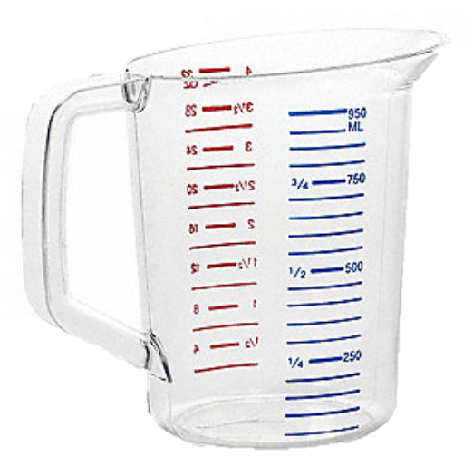
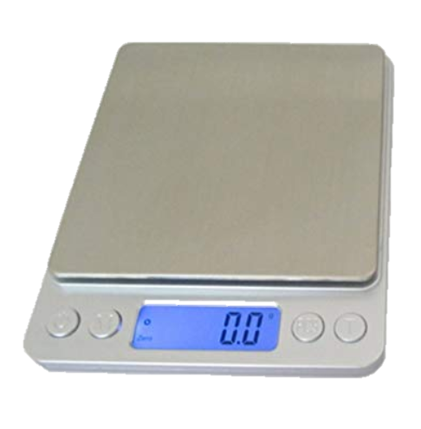
How To Control Food Cost Cont’d
Portion Control
Use the correct portion sizes per standardized recipes
Train staff on the correct usage of measuring equipment and portion control tools
Monitor staff periodically to ensure compliance
Record all FSD employee meals
Notes:
TELL: Next we will discuss ways on how to control food cost through portion control. It is important to use the correct portion sizes per standardized recipes. Over portioning or under portioning an item will effect an operations financial performance. Next, train all staff on the correct usage of measuring equipment and portion control tools and monitor staff periodically to ensure compliance. Again, if employees are under or over portioning items it will effect an operations financial performance. Lastly, an operation will need to accurately record all employee meals as meals provided to employees are a financial loss and need to be accounted for.

Slide 29
How To Control Food Cost
Storing
Prevent waste by practicing FIFO (First In, First Out)
Keep all storage areas organized
Store like items together in the same place
Reduce Waste
Review production history
BIC, Lunch, and Supper
Do not over produce food items:
Over Production = Waste
Follow Offer vs. Serve guidelines
Notes:
TELL: Let’s talk about storing goods and reducing waste. Waste can be prevented by practicing the standard of FIFO (First In First Out). You also need to keep all storage areas organized and store “like” items together in the same place. For instance, you won’t want to store two cases of pinto beans on the bottom of a shelf and one case on the other side of store room. The same would go with the freezers and refrigerators. If could be difficult to keep a count of shredded cheese if you store a case in the walk-in refrigerator and an excess supply in a reach-in refrigerator.

Slide 30
CMS Production Profit and Loss Report
A Profit and Loss Report (P&L) is a report that shows the total income and expenses in a specific period of time.
Managers will generate report on a daily basis from CMS.
Review the report for red flags.
“Total Cost Per Meal” are in line with the target meal cost.
The number of “Meals Served” has the correct quantity entered.
Notes:
TELL: Production Profit and Loss Report is generated from CMS daily. Food Service Managers or designee will review the report for the following red flags: Number of “Meals Served” has the correct quantity entered; and “Total Cost Per Meal” are in line with the target meal cost.
NEXT SLIDE:

Slide 31
Cost Per Meal Target
The cost per meal target is established by Food Services to stay on target to produce a desired profit margin.
“Total Cost Per Meal” are in line with the target meal cost.
Costs exceeding the target meal cost need to be evaluated by reviewing the CMS Production Record for errors and excessive waste.
Breakfast - $1.02
Lunch - 1.53
Snack - $0.51
Supper - $1.53
Notes:
TELL: The cost per meal target is established by Food Services to stay on target to produce a desired profit margin. The cost per meal target for each meal service is as follows;
Breakfast - $1.02
Lunch - 1.53
Snack - $0.51
Supper - $1.53
Costs exceeding the target meal cost need to be evaluated by reviewing the CMS Production Record for errors and excessive waste.
NEXT SLIDE:

Slide 32
Problem Solving for P & L
“Total Cost Per Meal” are in line with the target meal cost.
The number of “Meals Served” has the correct quantity entered.
Portion size indicated incorrectly
Such as “one case” versus “one serving” is selected
Meal/Revenue tab was not completed in CMS Production Record
Daily Entry
Incorrect data entry
Such as “amount leftover” or “amount used”
Breakfast in the classroom meals not entered
Notes:
TELL: Problem solving for profit and loss means to review in detail the Production Record Report to identify any issue. The most common issues include keeping total cost per meal in line with the target meal cost, and ensuring the number of meals served is properly entered for reimbursement. Let’s talk about the factors that will effect the total cost per meal first; there is portion size being indicated incorrectly, for example; case was entered instead of each, serving, and or disher number. To correct the issue the manager would reopen the production record and correct the portion error. Now let’s review meals served being incorrectly entered. When the Meal/ Revenue tab is not completed within the Production Record, meals are not recorded and sent down town for reimbursement. Same goes for daily entry, and entering in breakfast in the classroom numbers. If numbers are not entered or entered incorrectly then reimbursements can not be claimed.
NEXT SLIDE:

Slide 33
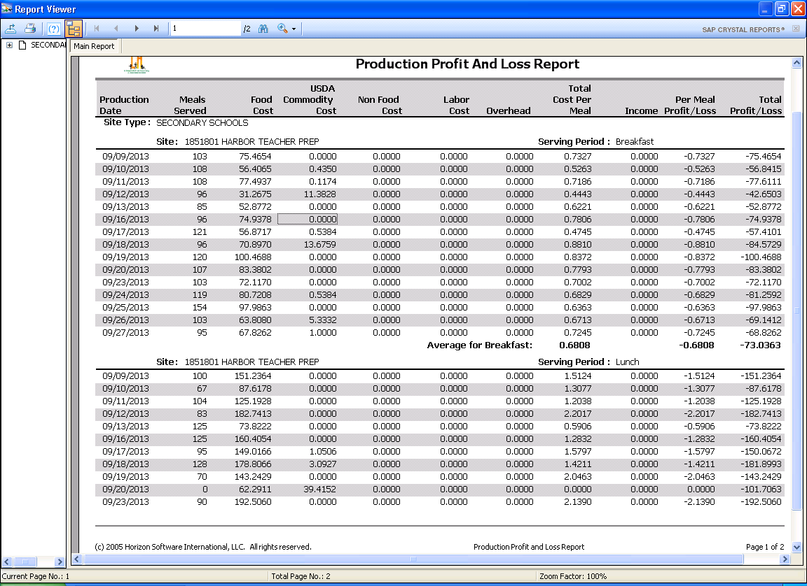
Cost Per Meal Inline With Target Cost
Total Cost Per Meal
0.7327
0.5263
0.7186
0.4443
0.6221
0.7806
0.4745
0.8810
0.8372
0.7793
0.7002
0.6829
0.6363
0.6713
0.7245
Find the “Total Cost Per Meal” column to ensure the cost per meal are inline with target cost.
Costs that are usually low or over the target cost should be evaluated.
1.437
Notes:
TELL: Let’s examine the total cost per meal column for the breakfast meals reported in our example. Looking at the area highlighted in the red box, all of the breakfast cost per meal are under the target cost of $1.02 except for one at $1.437. Although we want to be in line with the target cost we must note that being too below the target meal cost could indicate input errors as well. Notice there is a low $ .4443 cost. Possibly, either the participation numbers are inflated or incorrect data was entered into the Production Record. When reviewing the production profit and loss report always look for figures that are too high or too low in regards to the cost per meal target.
NEXT SLIDE:

Slide 34
Activity: Breakfast Production Profit And Loss Report Example
Production Date | Meals Served | Food Cost | USDA Commodity Cost | Non Food Cost | Labor Cost | Overhead | Total Cost Per Meal
04/10/2013 | 150 | 2,342.2137 | 0.0000 | 0.0000 | 0.0000 | 0.0000 | 15.61.48
True or False: This high cost error was caused by the portion size entered as a “case” and not by “each”.
Notes:
ACTIVITY: Breakfast Production Profit And Loss Report Example
ASK: True or False
Select the correct answer: This high cost error was caused by the portion size entered as a “case” and not by “each”.
SOLICITE RESPONSES: Thank those for participating.
TELL: The answer is True
The error was caused when the food item portion size was entered as a “case” count not by the “each” count on the breakfast production report.
NEXT SLIDE:

Slide 35
Activity: Lunch Production Profit And Loss Report Example
Production Date | Meals Served | Food Cost | USDA Commodity Cost | Non Food Cost | Labor Cost | Overhead | Total Cost Per Meal
04/15/2013 | 0 | 197.1679 | 0.0000 | 0.0000 | 0.0000 | 0.0000 | 0.0000
True or False:
The Production Record meal counts were not entered into the CMS Meal/Revenue tab.
Notes:
TELL: The Production Record meal counts were not entered into the Meal/Revenue tab.
True or False
SOLICITE RESPONSES: Thank those for participating.
TELL: The answer is True.
The Production Record meal counts were not entered into the Meal/Revenue tab
NEXT SLIDE:

Slide 36
Preventing Missing Meals
The following are examples of why missing meal counts occur and how to prevent to them;
Reason
Solution
Time
Delegate task to employees
Alter schedule to accommodate all tasks
Short Staffed
Cross train staff to cover tasks that can be delegated by the manager
Connectivity
Place a remedy ticket
Notify supervisor of issue
Notes:
TELL: When meals are not entered into CMS, reimbursements are not being requested and revenue is not being received. The following are reasons for meals not being entered and how to prevent them from being an issue. Time-To prevent time from being an issue a manager will delegate task to employees or alter the cafeterias schedule to accommodate for all tasks. Next is being short staffed, cross training staff to cover tasks that can be delegated by the manager will allow the manager to complete data entry. Lastly there is connectivity, there are times when the manager enters in all the numbers but the connectivity of the computer to downtown is not connected. If this occurs, place a remedy ticket, and notify the supervisor of issue.

Slide 37
Dashboard Overview
Dashboard is an additional tool for food service managers to monitor meal counts and revenue data.
Total Meals Served
ADP
Breakfast
ADP
Lunch
ADP
Supper
Revenue
Notes:
Tell: Dashboard is an additional tool for food service managers to monitor meal counts and revenue data. Lets take a look at the 5 column on the home page, there are the total meals served, revenue, and average daily participation or ADP for breakfast, lunch and supper.

Slide 38
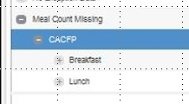
Dashboard and Missing Meals
Managers can access the Dashboard to review for missing meals before a “Missing Meal List” is distributed.
Meal Counts
187567 – ABC HS
187567 – ABC HS
187567 – ABC HS
187567 – ABC HS
0
0
0
0
Step by step instructions can be found on the FSD website under Training and Resources.
Notes:
TELL: A missing meal list is often distributed by supervisors to managers. Managers can use dashboard to periodically check to ensure they are not on the missing meals list. For step by step instructions on how to use the dashboard please visit the food service division website under the training and recourses page.

Slide 39
Questions?
LAUSD Food Services Division
Nourishing Children to Achieve Excellence
Notes:
TELL: Any Question? Thank you for attending today’s training.

